Slide 1
ZOMATO RESTAURANT & ORDER ANALYSIS
Using MySQL Workbench 8.0
Microsoft Power BI
BY
T. KAVITHA JAYENDRAN
GUVI Capstone Project 2026

Slide 2
PROJECT OVERVIEW
Analyzes Zomato restaurant and order data using MySQL and Power BI to generate business insights.
Objectives
📥 Import datasets into MySQL
✔ Validate duplicate & NULL values
🗄 Perform SQL analysis
📈 Analyze customer ordering trends
📊 Build an interactive Power BI dashboard
💡 Generate business insights

Slide 3
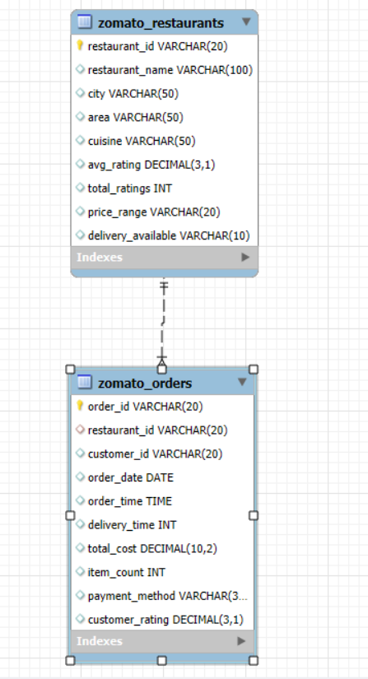
Project Description & Database Design
This project uses MySQL to store and analyze Zomato restaurant and order data. SQL analysis is performed to generate insights, which are visualized using Power BI.
TABLES | DESCRIPTION
Zomato Restaurants | Stores restaurant details such as name, city, cuisine, rating, and price range.
Zomato Orders | Stores order details including date, cost, payment method, and customer rating
Relationship: One Restaurant can have Multiple Orders (One-to-Many relationship using restaurant_id)

Slide 4



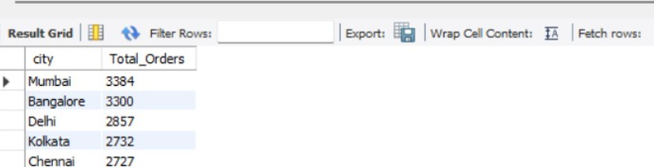
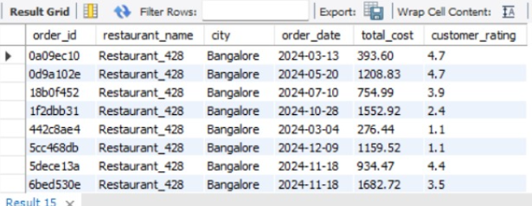
Data Import & Validation
Data Import
Imported restaurant and order datasets into MySQL.
Loaded both CSV files into separate tables.
Verified successful import.
Data Validation
Checked for NULL values.
Identified duplicate records.
Verified data types.
Ensured referential integrity.

Slide 5
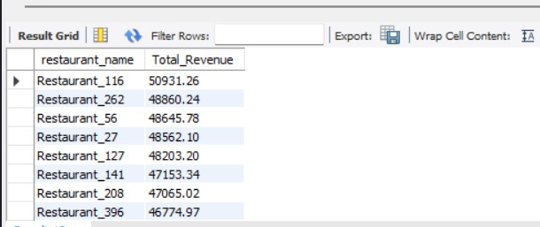
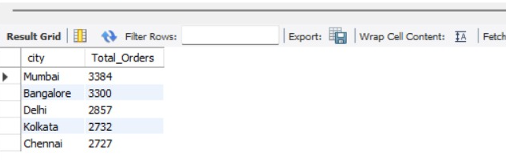
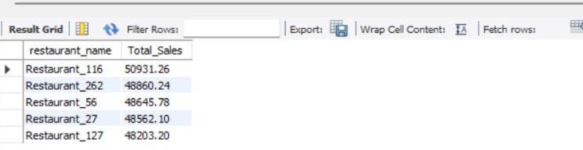
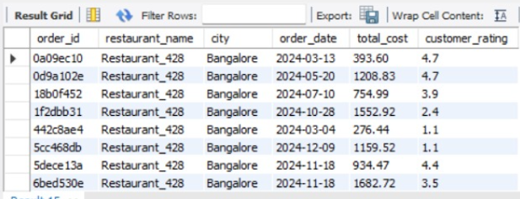
SQL Analysis
SQL Analysis & Business Queries
Include:
  Total Revenue
  Average Rating
  Top Restaurants
  Orders by City
  Revenue by City
Key Outcome
SQL queries helped identify revenue trends, customer preferences, and top-performing restaurants

Slide 6
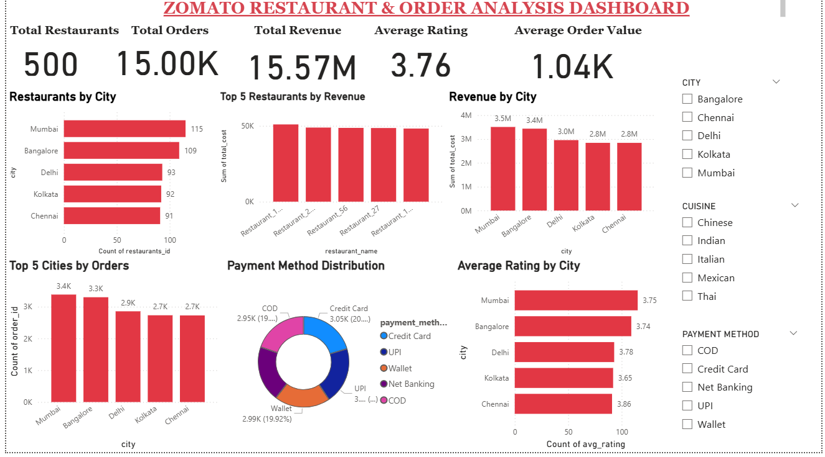
Power BI Dashboard
Dashboard Highlights
KPI Cards
Revenue Analysis
Restaurant Performance
Customer Ratings
Payment Analysis
Interactive Filters

Slide 7
KEY INSIGHTS
Business Insights
📈 Mumbai generated the highest revenue.
🏪 Mumbai has the highest number of restaurants (115).
💰 Total Revenue: ₹15.57M from 15K orders.
⭐ Average customer rating: 3.76.
💳 Credit Card, UPI & Wallet are the most preferred payment methods.
🍽️ Top 5 restaurants contribute the highest sales.
🛒 Average Order Value: ₹1.04K.
📍 Revenue is concentrated in a few major cities.

Slide 8
BUSINESS RECOMMENDATIONS
Recommendations
  🚀 Expand in high-revenue cities (Mumbai & Bangalore).
  📢 Increase promotions in Delhi, Kolkata & Chennai.
  ⭐ Improve service quality to increase customer ratings.
  ⚡ Reduce delivery time for better customer satisfaction.
  🎁 Introduce loyalty programs and special offers.
  💳 Continue supporting multiple digital payment options.
  📊 Use the dashboard for regular business monitoring.

Slide 9
CONCLUSION
Successfully analyzed restaurant and order data using MySQL.
Built an interactive Power BI dashboard.
Identified customer behavior and revenue trends.
Dashboard enables data-driven decision-making.
Insights can help improve restaurant performance and customer satisfaction.

